Slide 1
Research and Development Proposal (v0)

Slide 2
Anderson dos Santos Paschoalon
M.Sc. Student
Dr. Christian Esteve Rothenberg
Mentor

Slide 3
Agenda
Requirements and Goals
Main components (v0)
Component implementation
Validation
Next Workplan Preview

Slide 4
Requirements and Goals
What?
Create a software capable of “learn” traffic patters from real traces, and capable of mimic this behavior
How?
Create “compact trace descriptors” that store flow information in any markup language (XML/Json). Then, use a trafic genenerator API capable of “execute” these flows.

Slide 5
Requirements and Goals
How?
To implement these trace descriptors, it is proposed the use of machine learning classifiers, capable of “guess” what sort of flows are being transmitted. Based on a previous learning process. Simple measurable flow features, like throughput and start/end time, could be directly measured.
And, to classify these flows, a flow-spliter is need.

Slide 6
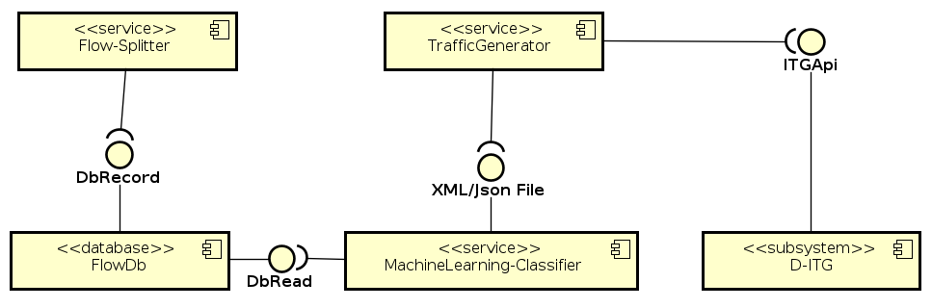
Main components (v0)

Slide 7
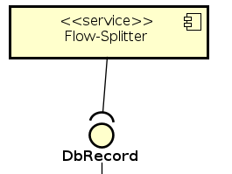
Main components (v0)
Flow-spliter
Responsible for split the colected traffic trace into flows, and store the useful colected data into a database.

Slide 8
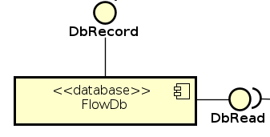
Main components (v0)
FlowDb
A database that store colected data into flows, for analysis.
The information should be written by the Flow-Spliitter component, and read by the Machine Learning component.

Slide 9
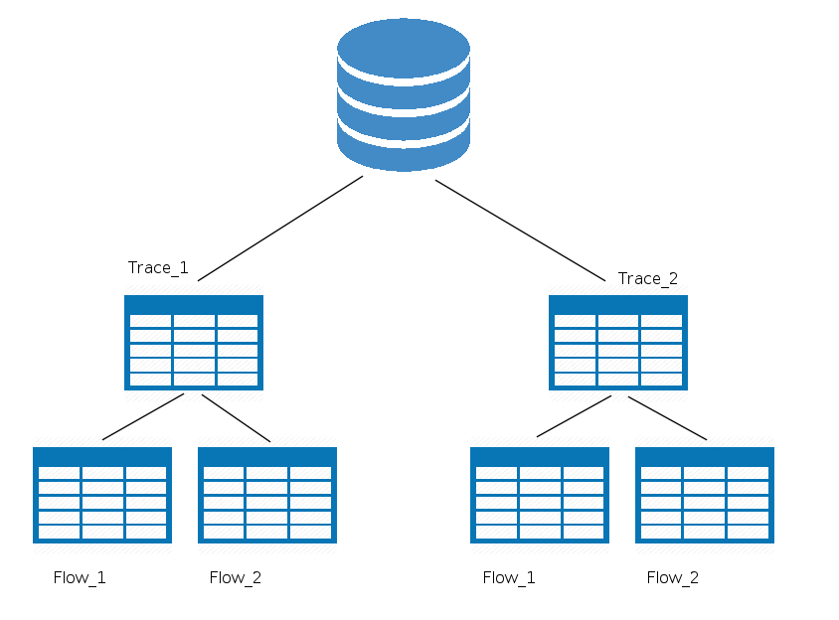

Main components (v0)
The database must store a table for each trace captured (one for each experiment), and each one should store a table for each flow from this trace.
According to SQLite specifications, it should be the best option for a datase: simple and suitable for the amount of data (less then terabytes).

Slide 10
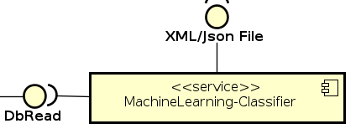
Main components (v0)
The Machine Learning Classifier should be able learn features form the measured traces, and record them into a machine-readable file (XML/Json).
Flow-level features, Packet-level QoS metrics and Leyer-4 features could be directely measured:
Flow-level properties: diration, start delay, total number of packets, total number of KBytes.
Packet-level QoS metrics: bitrate, packet, RTT, Jitter, packet loss.
Leyer-4 features: protocols TCP, UDP, ICMP, DCCP and SCTP.

Slide 11
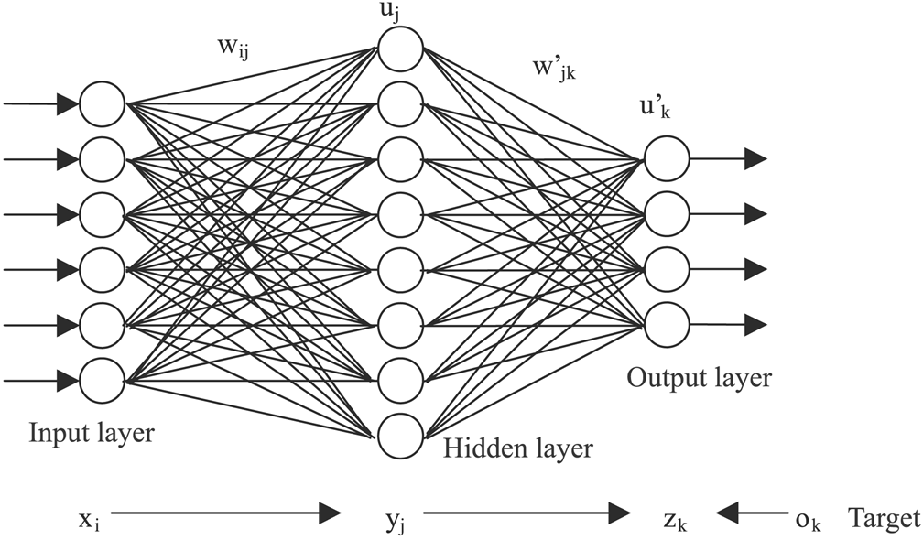

Main components (v0)
Stochastic modesl for PS(packet size) and IDT (Inter Departure Time) should use some Machine Learning technic to define what sort of profile the flow fits.
For exemple, a neural network is capable of classify somo profile of data into labels. These labels could be the workload profile (PS and IDT).

Slide 12
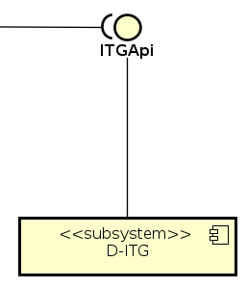
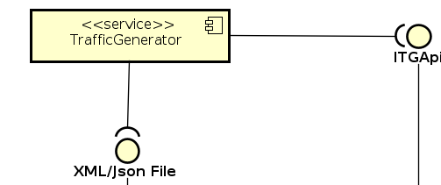
Main components (v0)
The traffic generator should be able to read the file created by the Machine Learning classifier (here called compact trace descriptor), and produce flows using these features.
To implement this task is going to be used the D-ITG API.

Slide 13
Component implementation
Now, some components implementations may be defined.
Flow-Spliter | not defined
FlowDb | SQLite
Machine Learning Classifier | not defined (Python or C++ API for machine learning)
Traffic Generator | C++ (First use D-ITG API, later it could be expanded)
CLI* | Klish(http://code.google.com/p/klish/) (C++ and XML)
(*) Item not mentioned before

Slide 14
Validation
First, the machine learning component should have a reasonable acuracy (higher as possible).
Compare syntethic trace shapes with real ones.
Feedback a generated trace shape, and compare the compac traces descriptors (before and after feedback).
First validation: capture a single flow produced by D-ITG, and implement single stochastic feature classification.

Slide 15
Next Workplan Preview
Activities | Week1 | Week2 | Week3 | Week4 | Week5 | Week6
(1) Bibliography review and report (latex): art state in traffic classification, and stochastic models for workloads.
(2) Flow Splitter implementation (v0) (for pcap files)
(3) Requiriments extraction for the Traffic Generator, and interface definition (Compact trace descriptor template).
(4) Traffic Generator implementation (v1)
(5) Database Requeriment extraction and definition.
(6) Database implementation (v0)
(7) Coursera: Practical Machine Learning
(8) Coursera: Machine Learning

Slide 16
Next Workplan Preview
Observations
The conclusion (2) and (6) (v1 of the component) should stay for the next Working Plan
The definition of the Machine learning model and metodology depends of (1) and (3).
(5) depends on (1)
(4) enables network tests.
If everything works as planed, the first validation will be possible at the end of the next working plan.
More detail about tools will be defined during the nexto working plan: these are just the guidelines for the next cicle, and a starting point for the research as a whole.
New itens could be added, until the “release” of the next WP.

